Slide 1



Slide 2

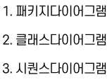


Slide 3




Slide 4
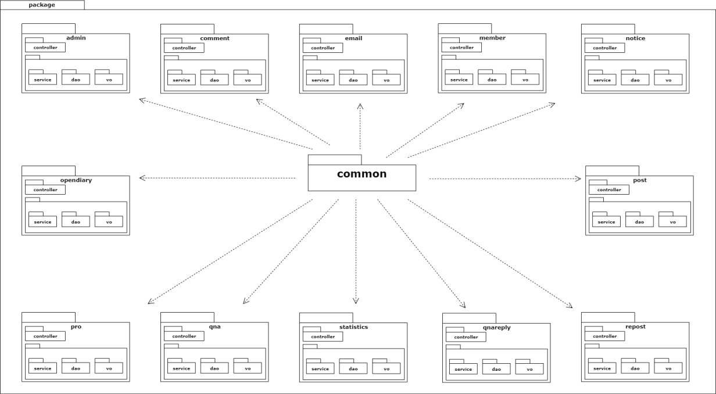

Slide 5




Slide 6
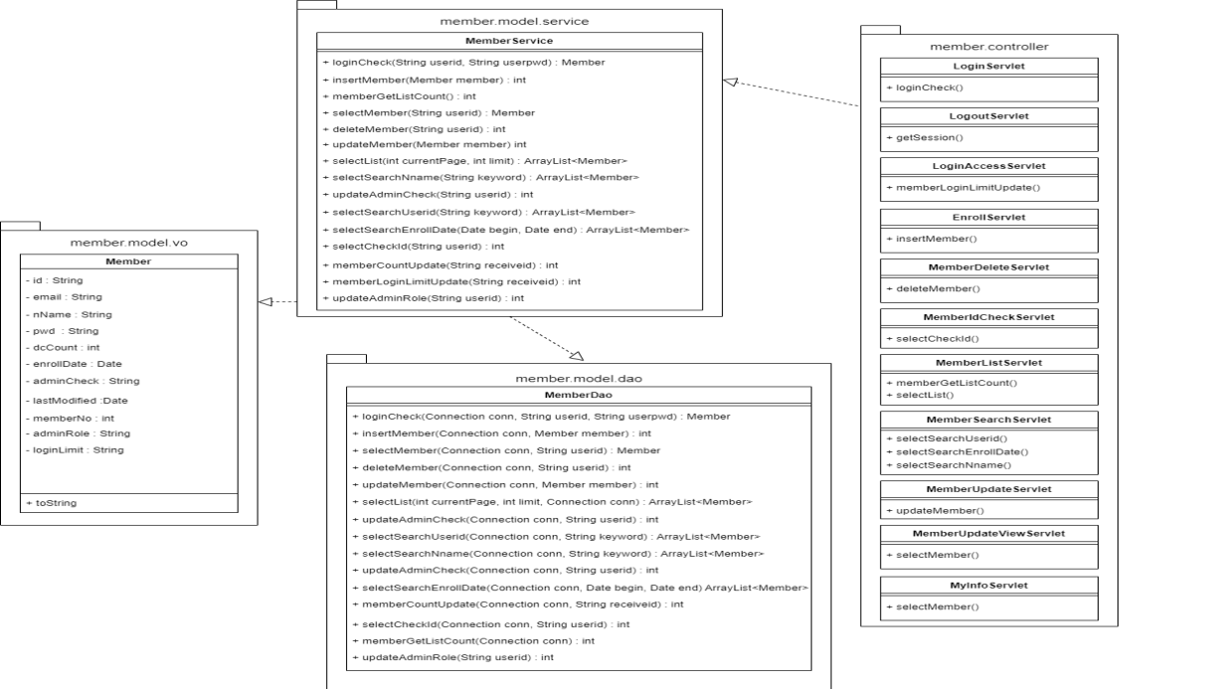
Member

Slide 7
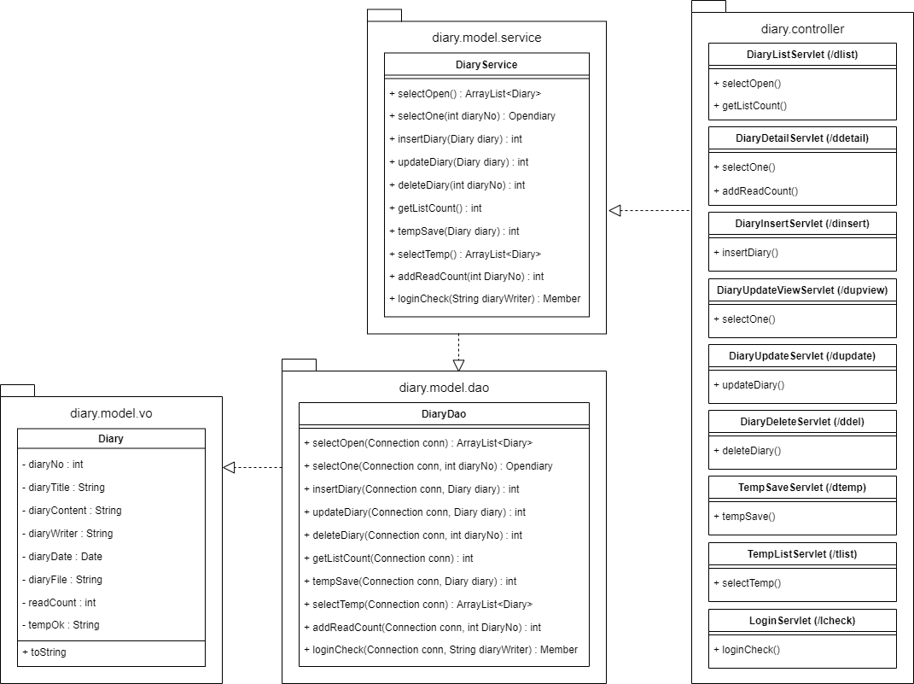
Diary

Slide 8
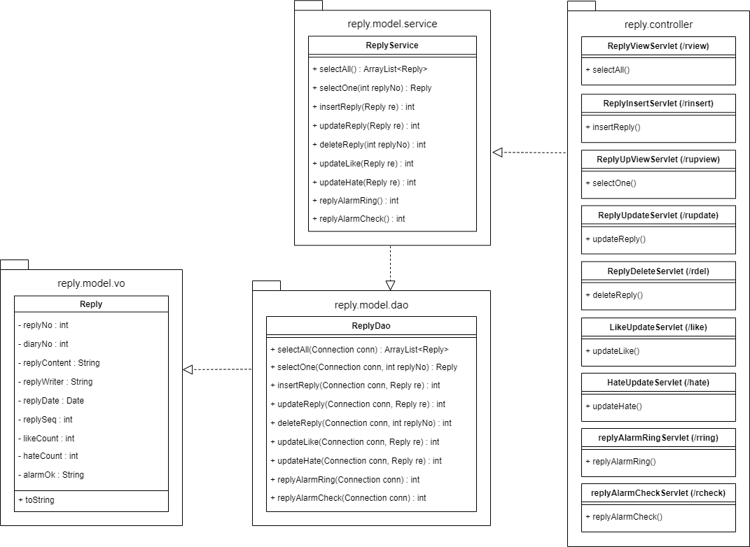
Reply

Slide 9
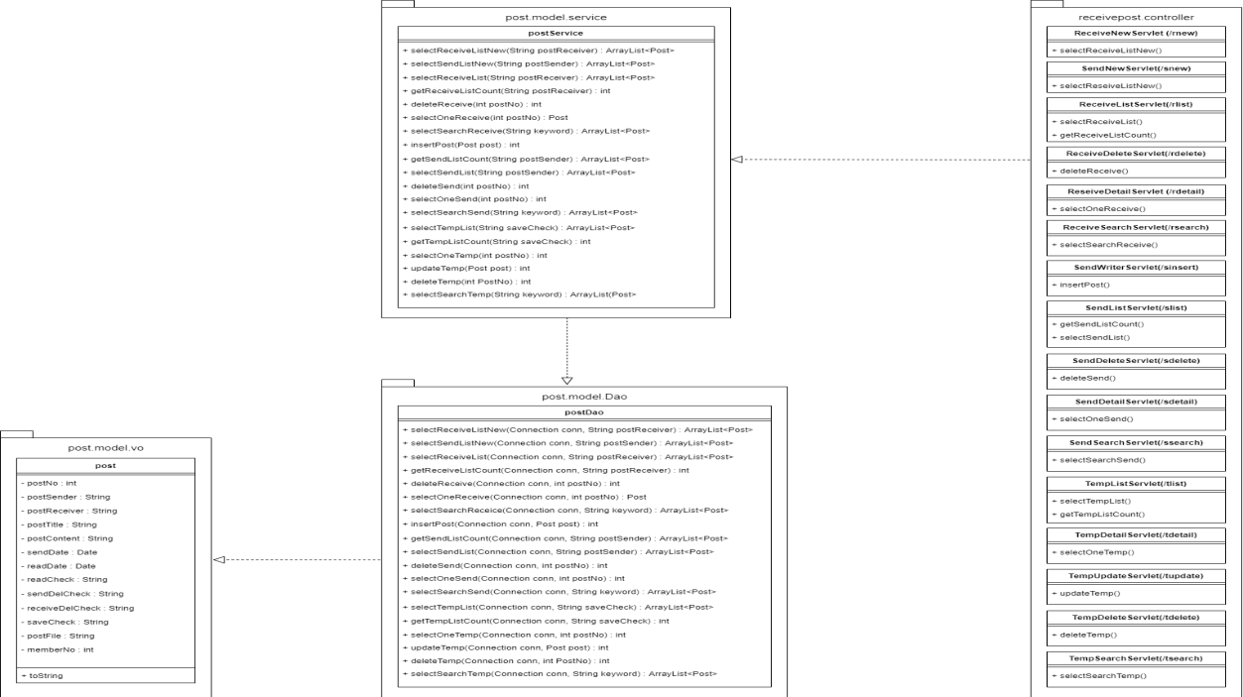
Post

Slide 10
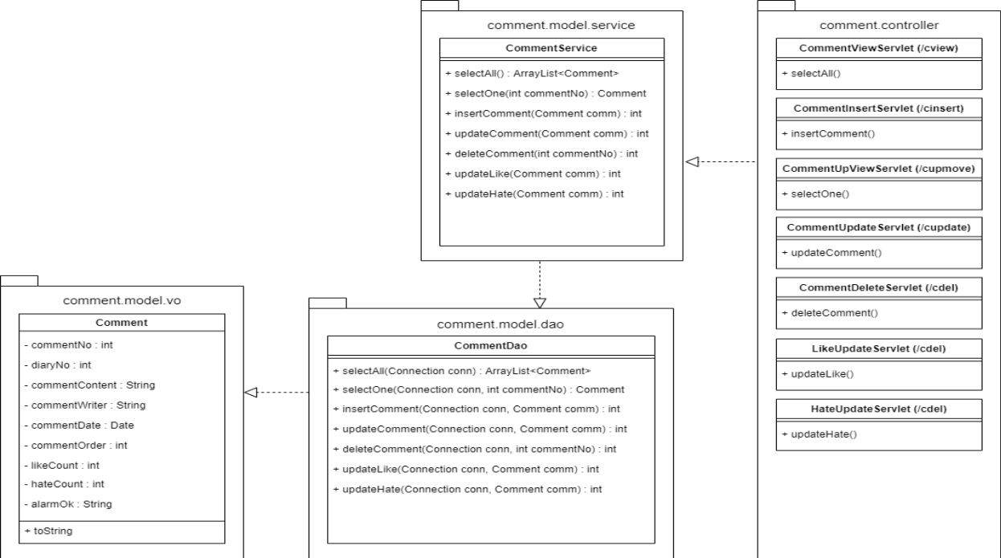
Comment

Slide 11
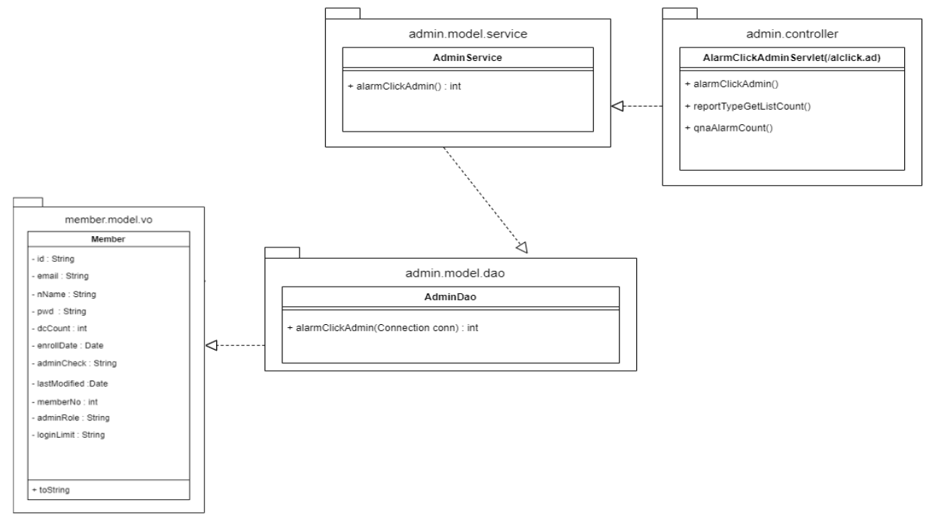
Admin

Slide 12
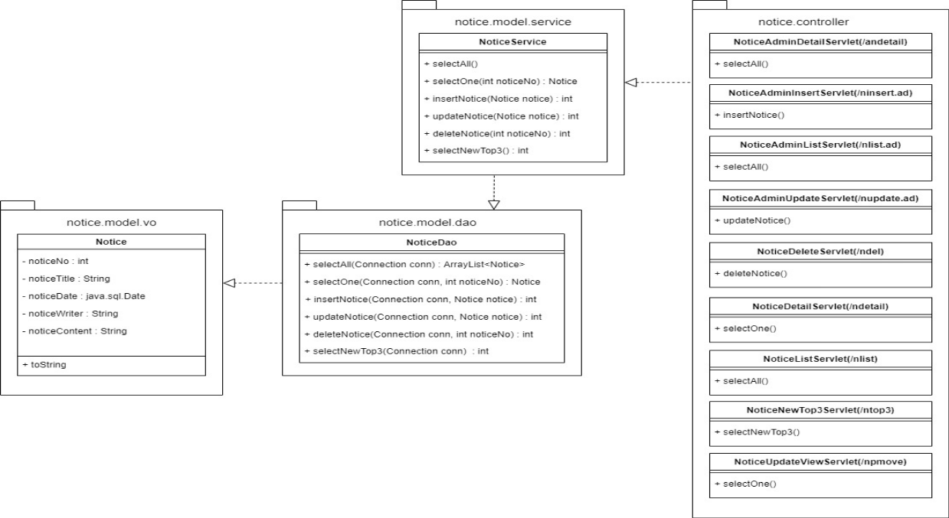
Notice

Slide 13
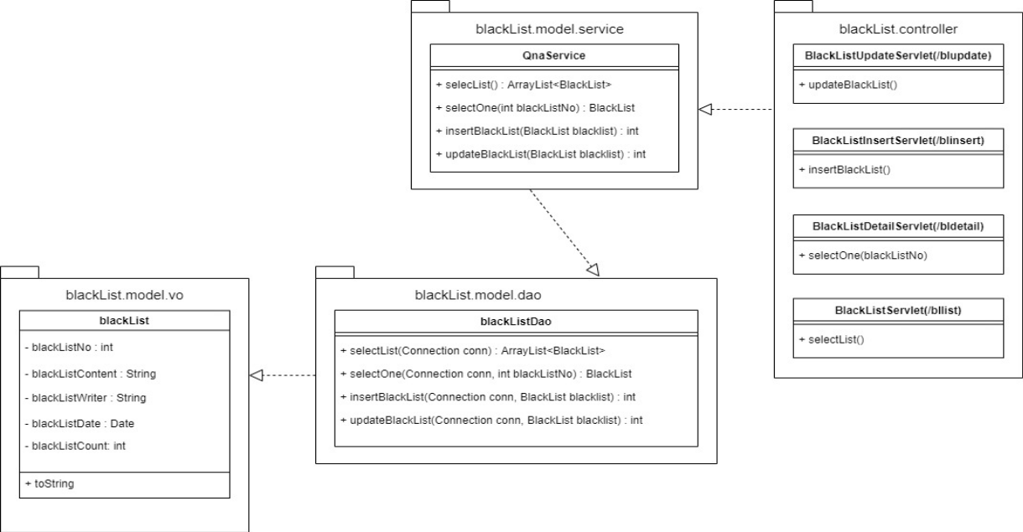
BlackList

Slide 14
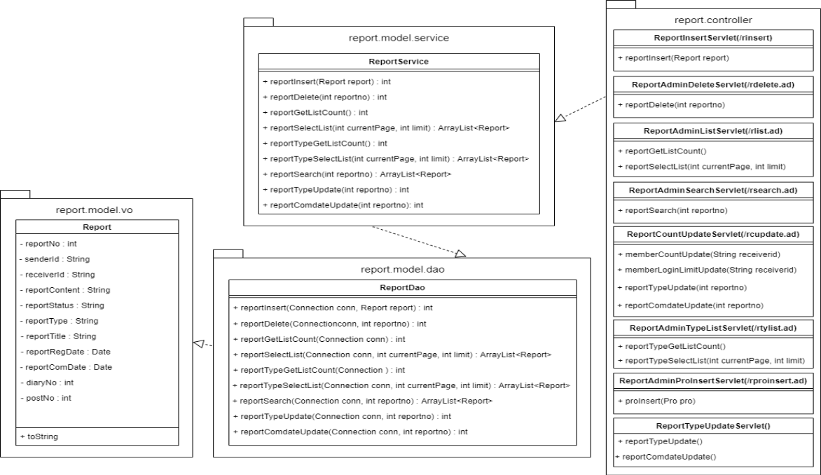
Report

Slide 15
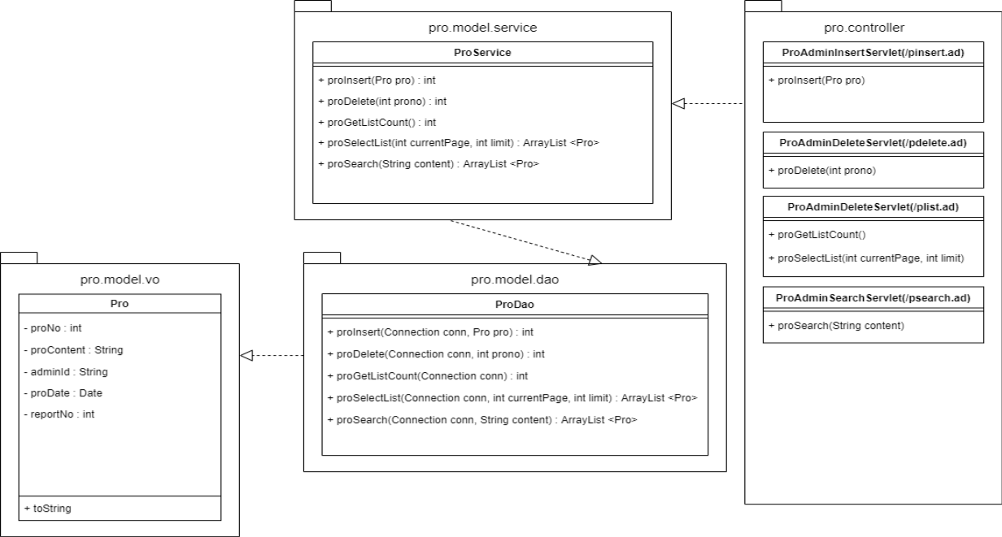
Pro

Slide 16
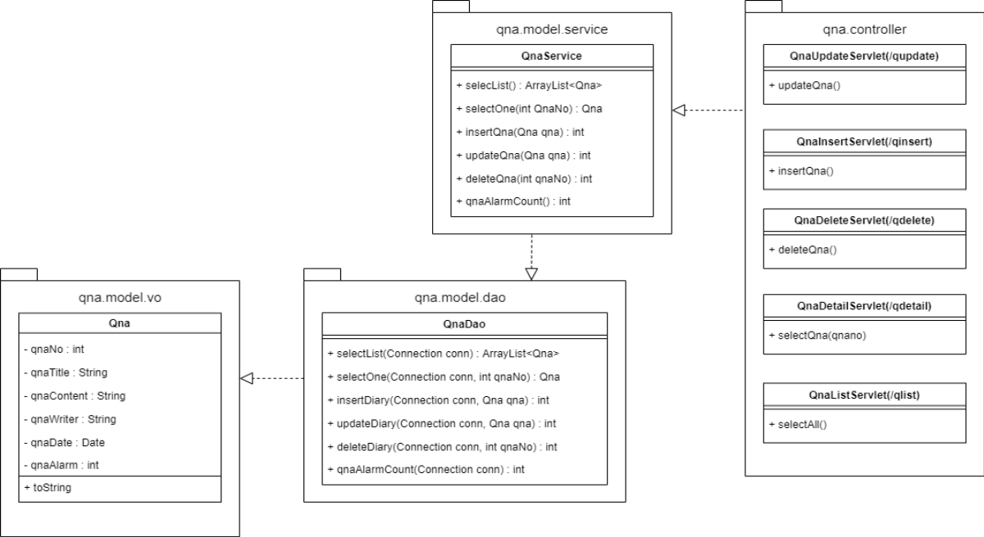
Qna

Slide 17
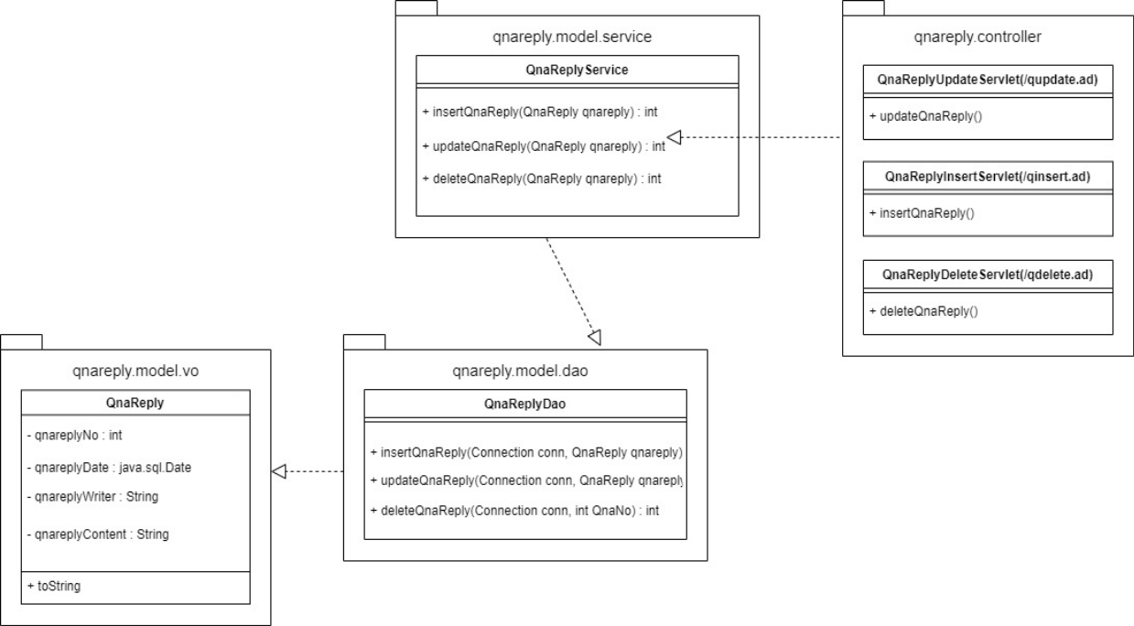
QnaReply

Slide 18
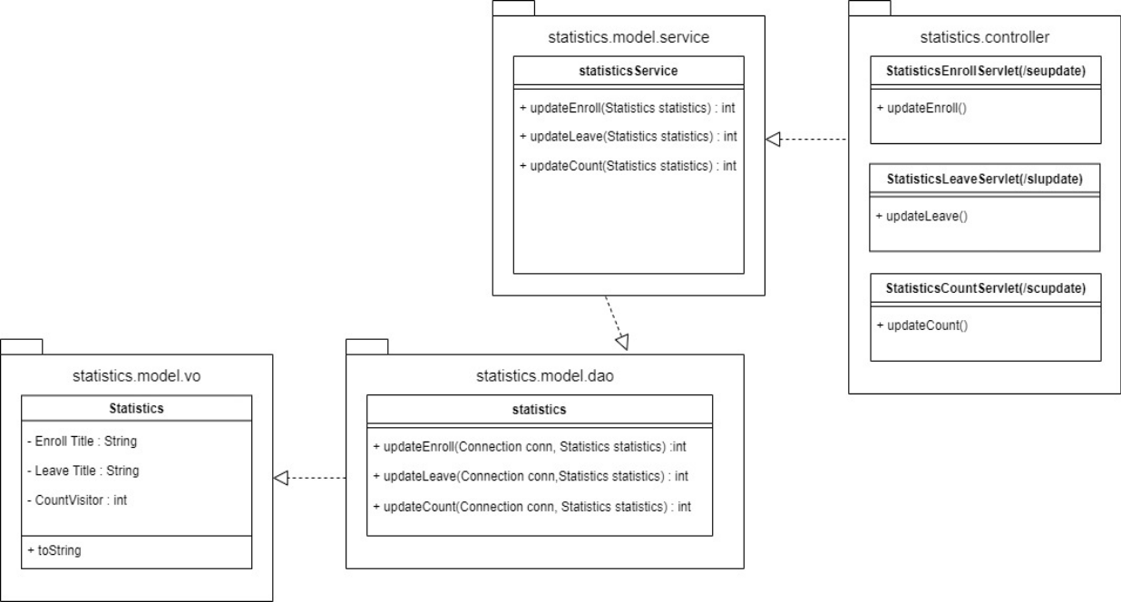
Statistics

Slide 19




Slide 20
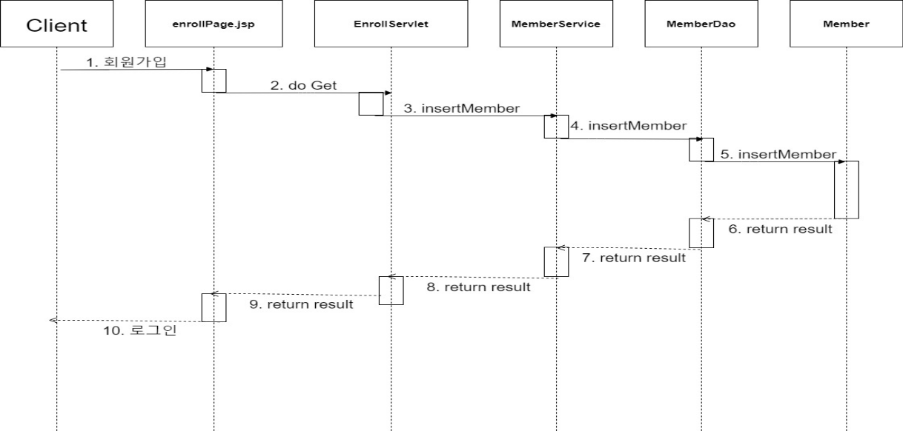
Enroll

Slide 21
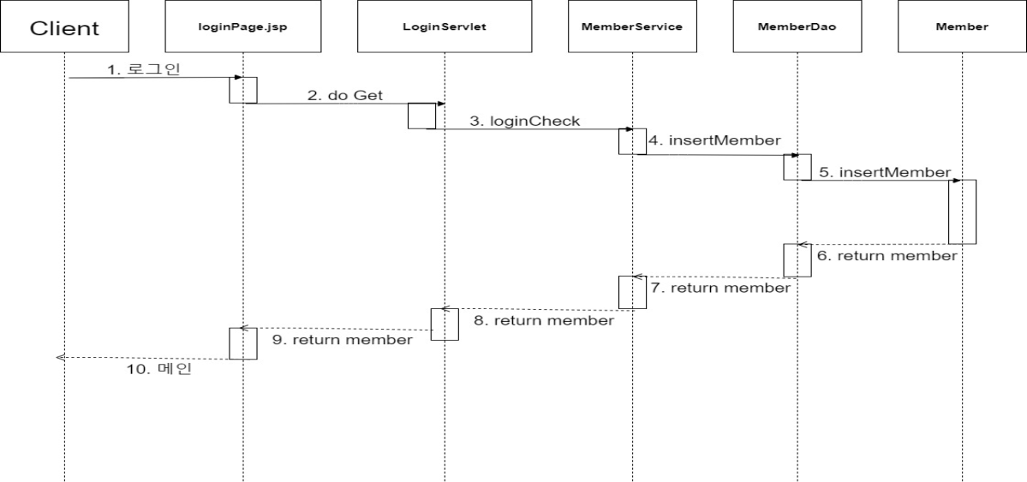
Login

Slide 22

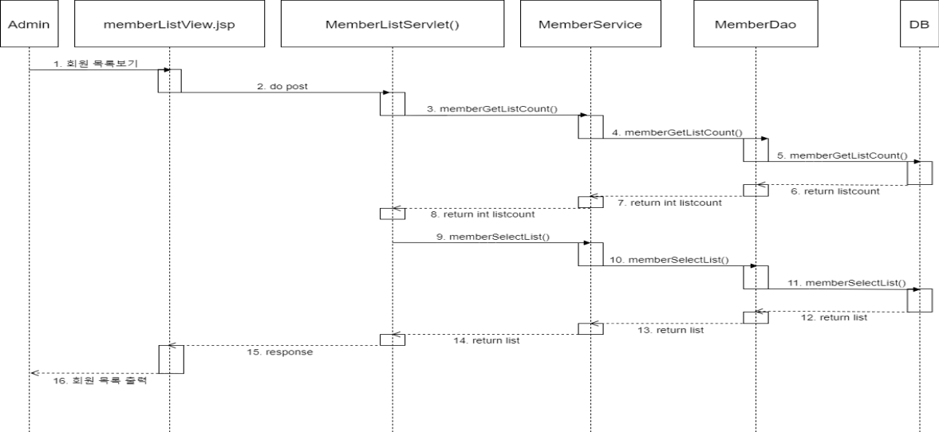

Slide 23

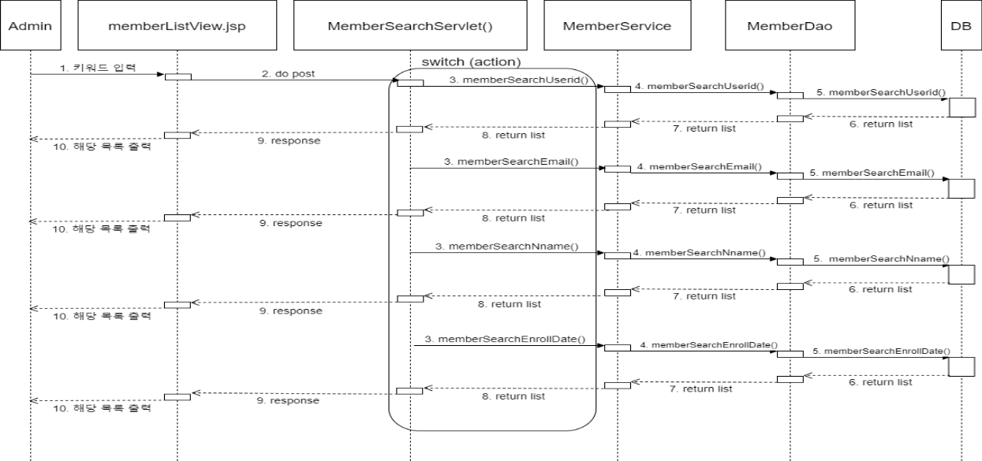

Slide 24

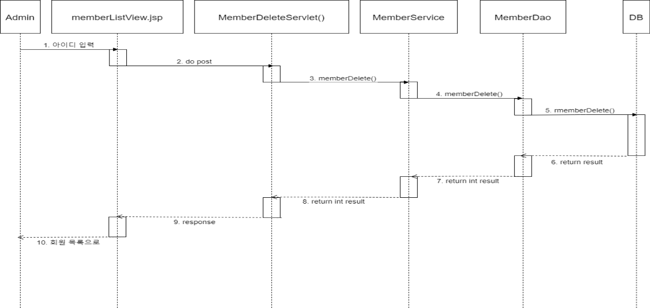

Slide 25
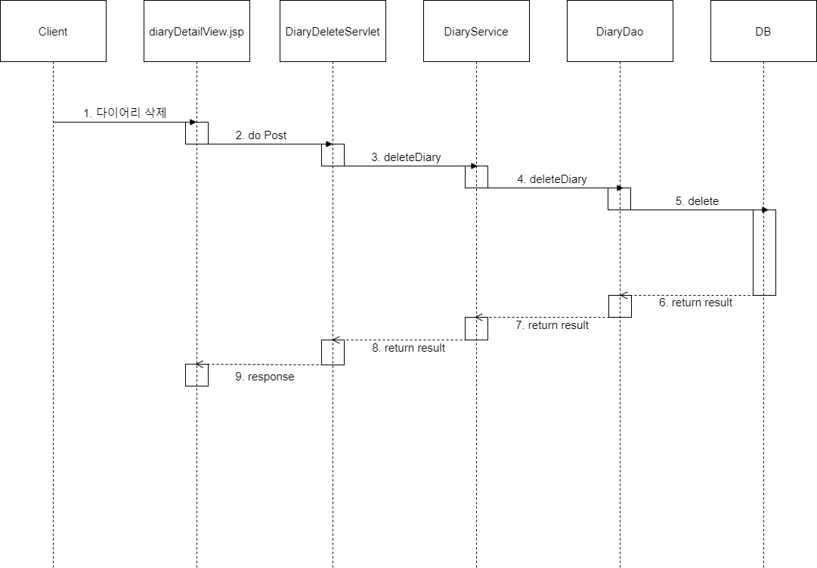
DiaryDelete

Slide 26
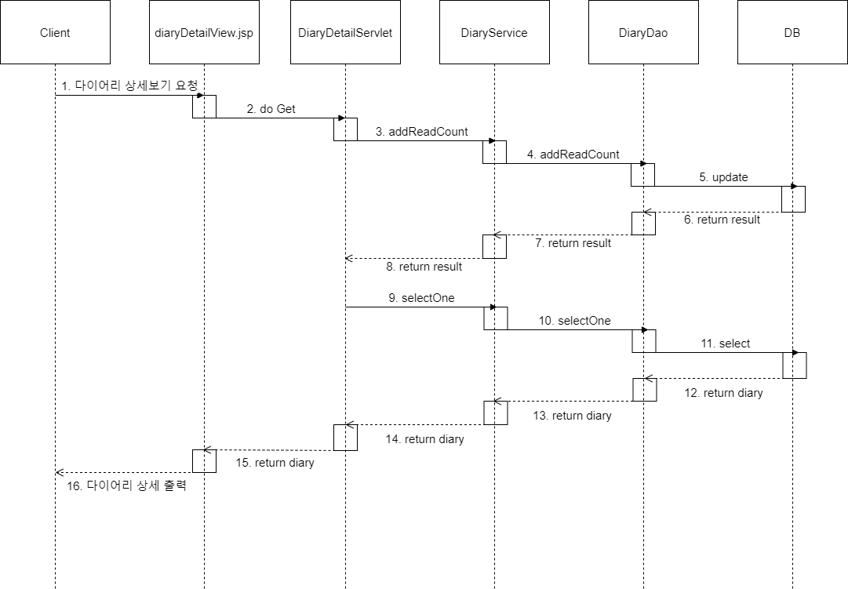
DiaryDetail

Slide 27
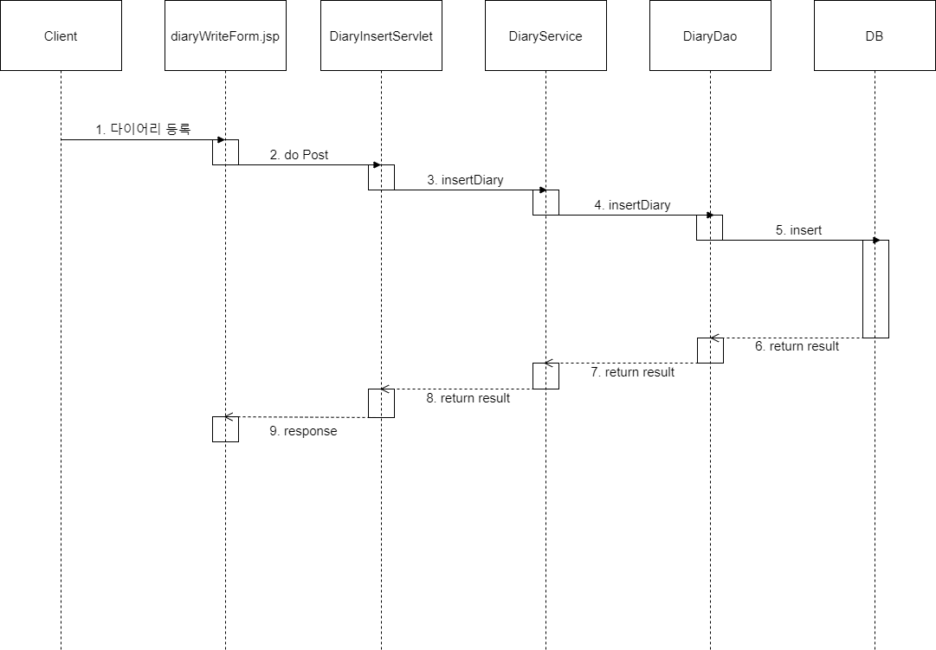
DiaryInsert

Slide 28
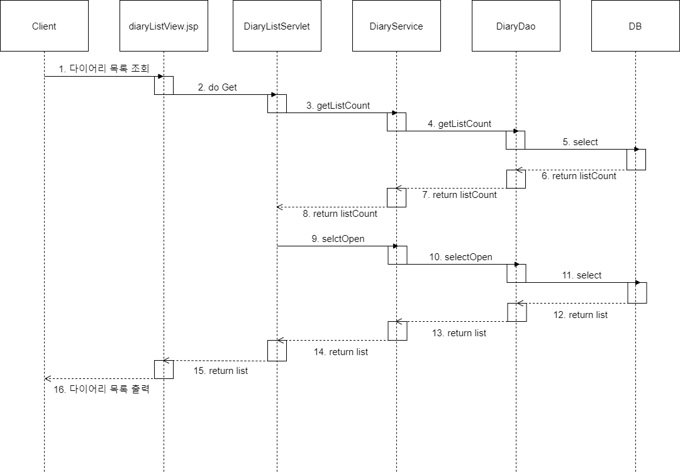
DiaryList

Slide 29

DiaryUpdate

Slide 30
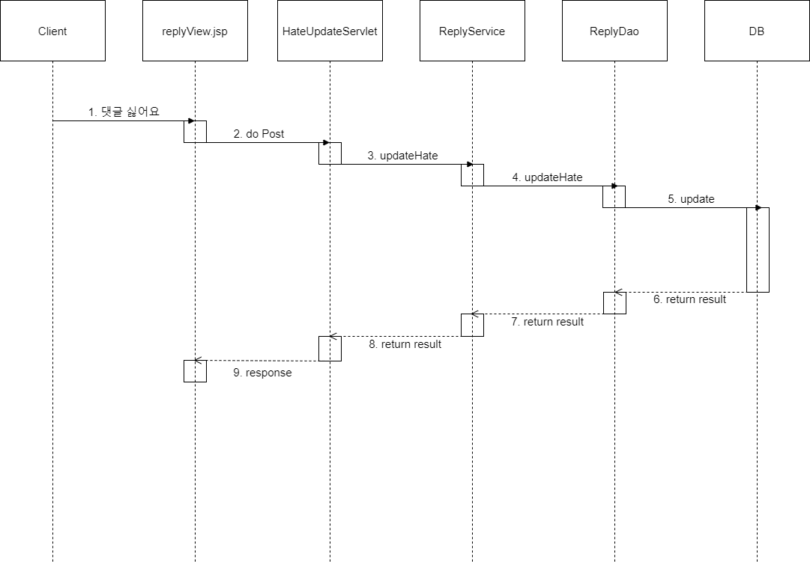
hateUpdate

Slide 31

LikeUpdate

Slide 32
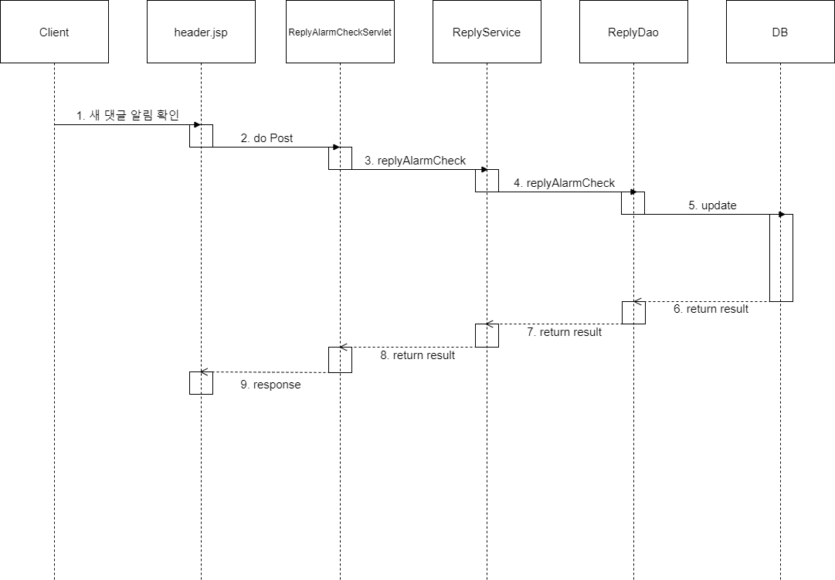
ReplyAlarmCheck

Slide 33
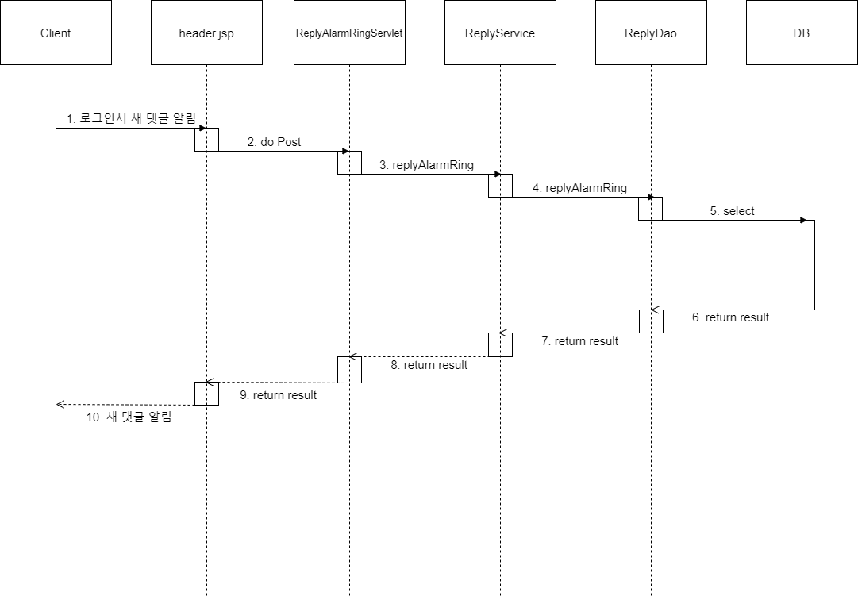
ReplyAlarmRing

Slide 34

ReplyDelete

Slide 35
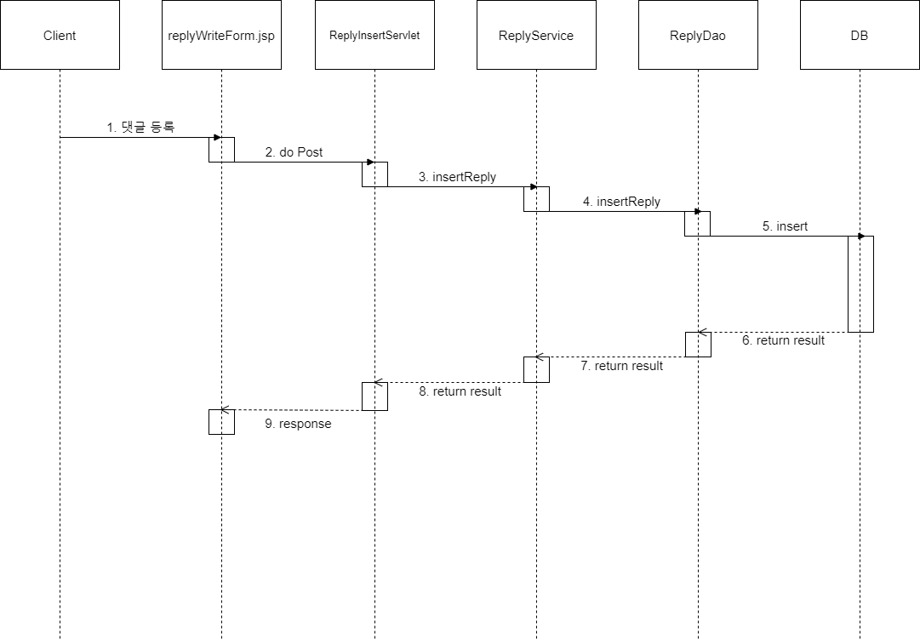
ReplyInsert

Slide 36

ReplyUpdate

Slide 37
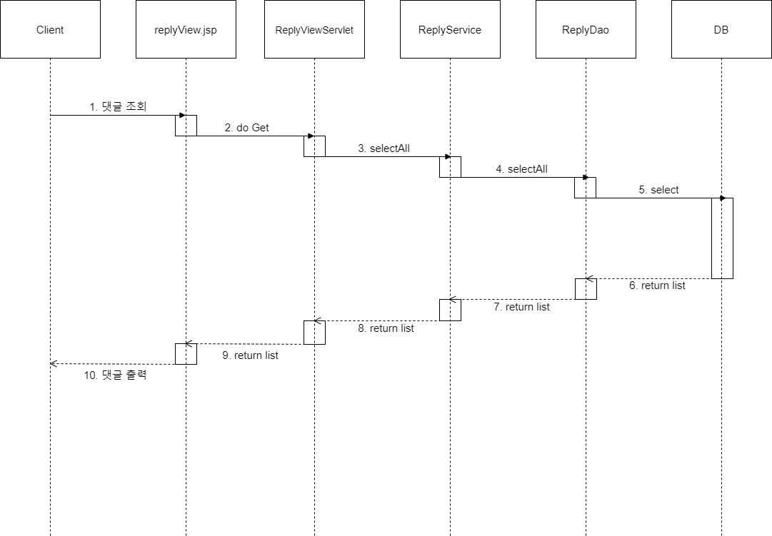
ReplyView

Slide 38
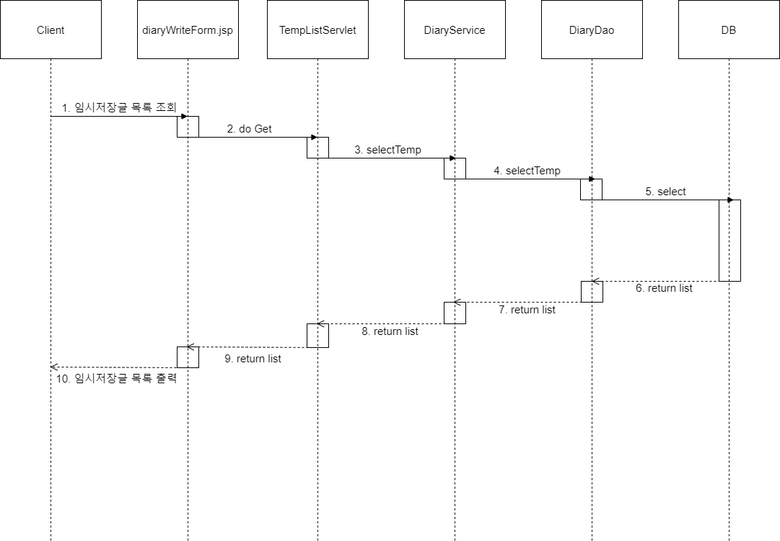
TempList

Slide 39
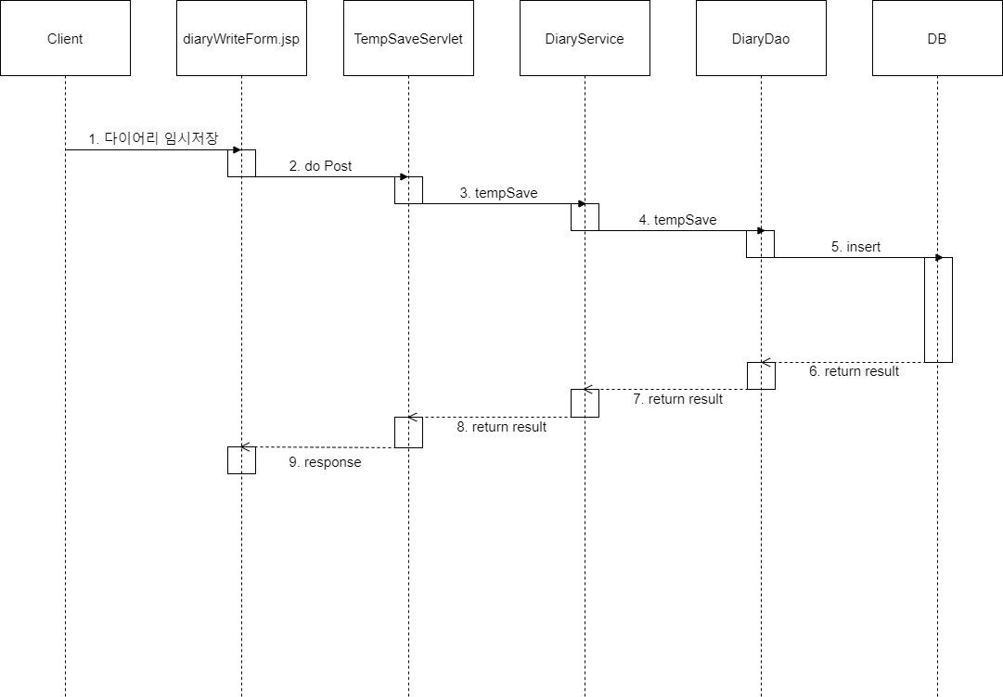
TempSave

Slide 40
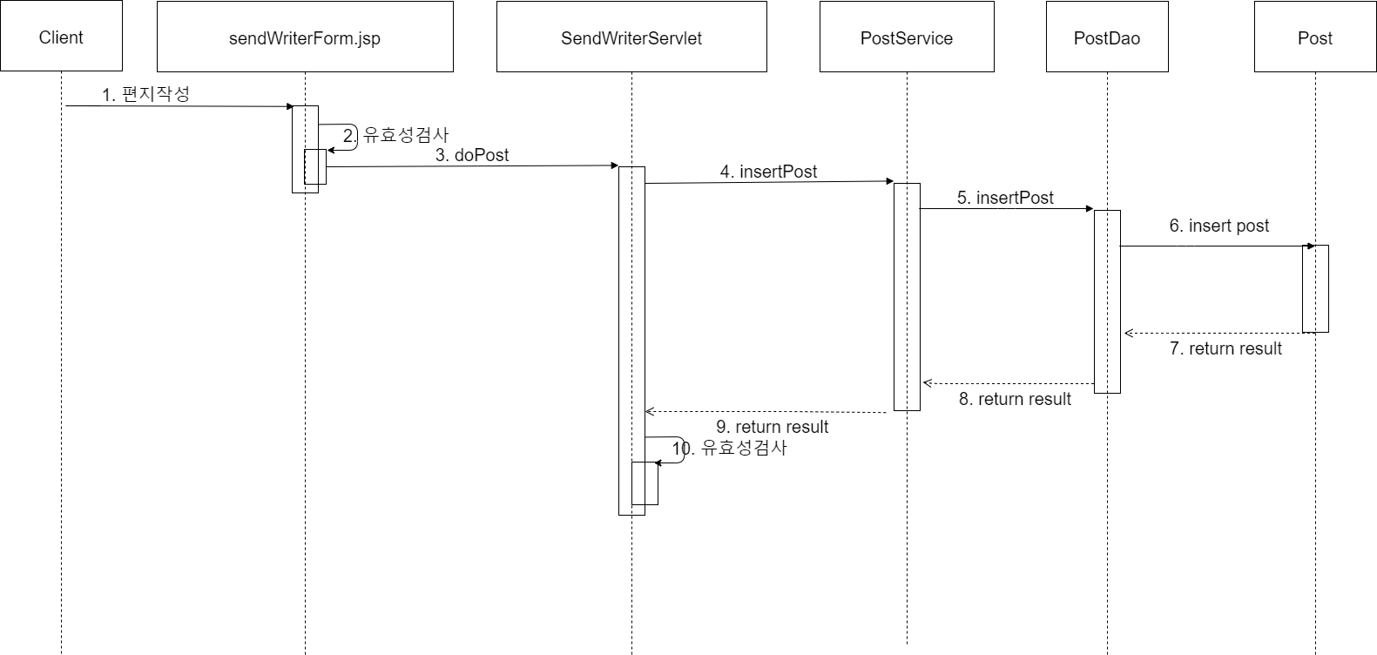
Write

Slide 41
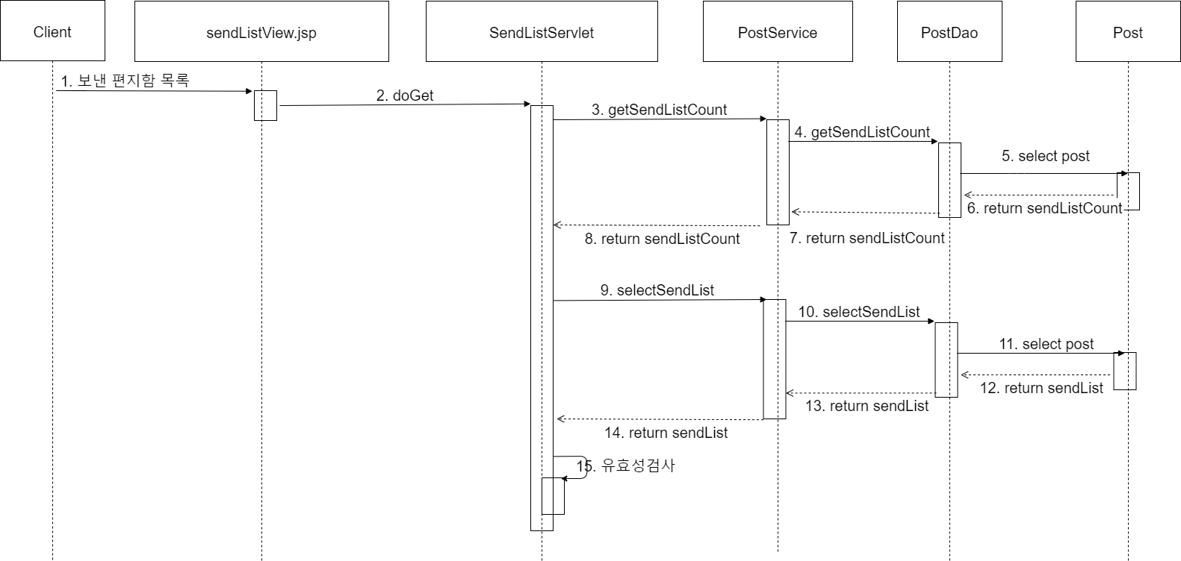
SendList

Slide 42
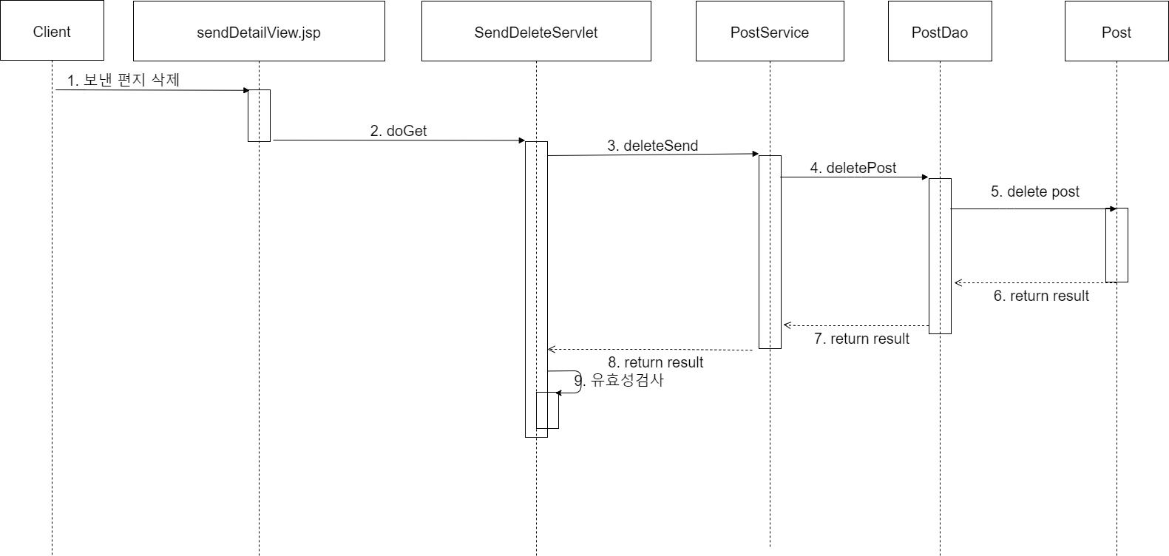
SendDelete

Slide 43
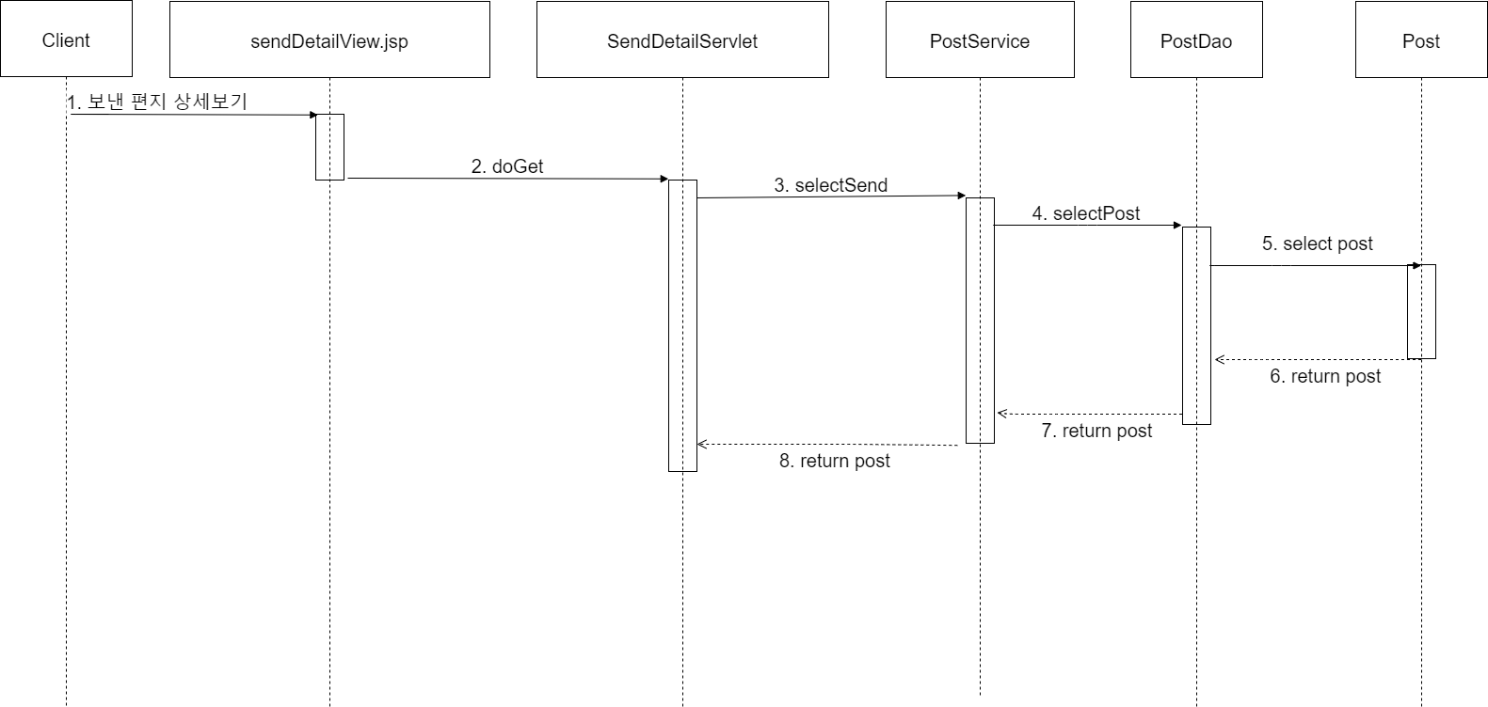
SendDetail

Slide 44
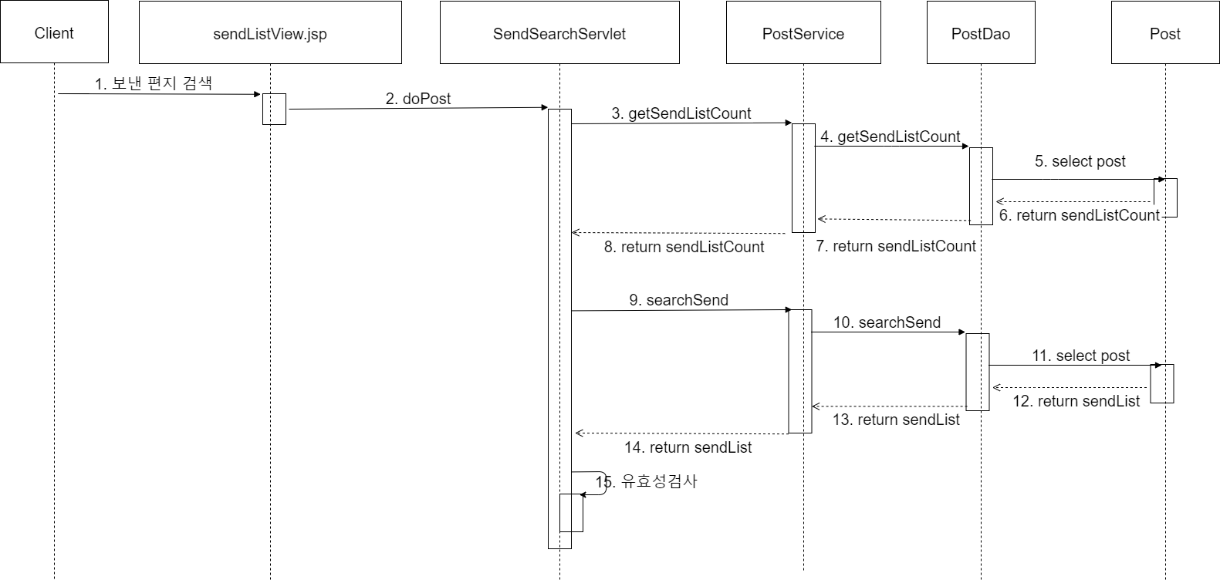
SendSearch

Slide 45
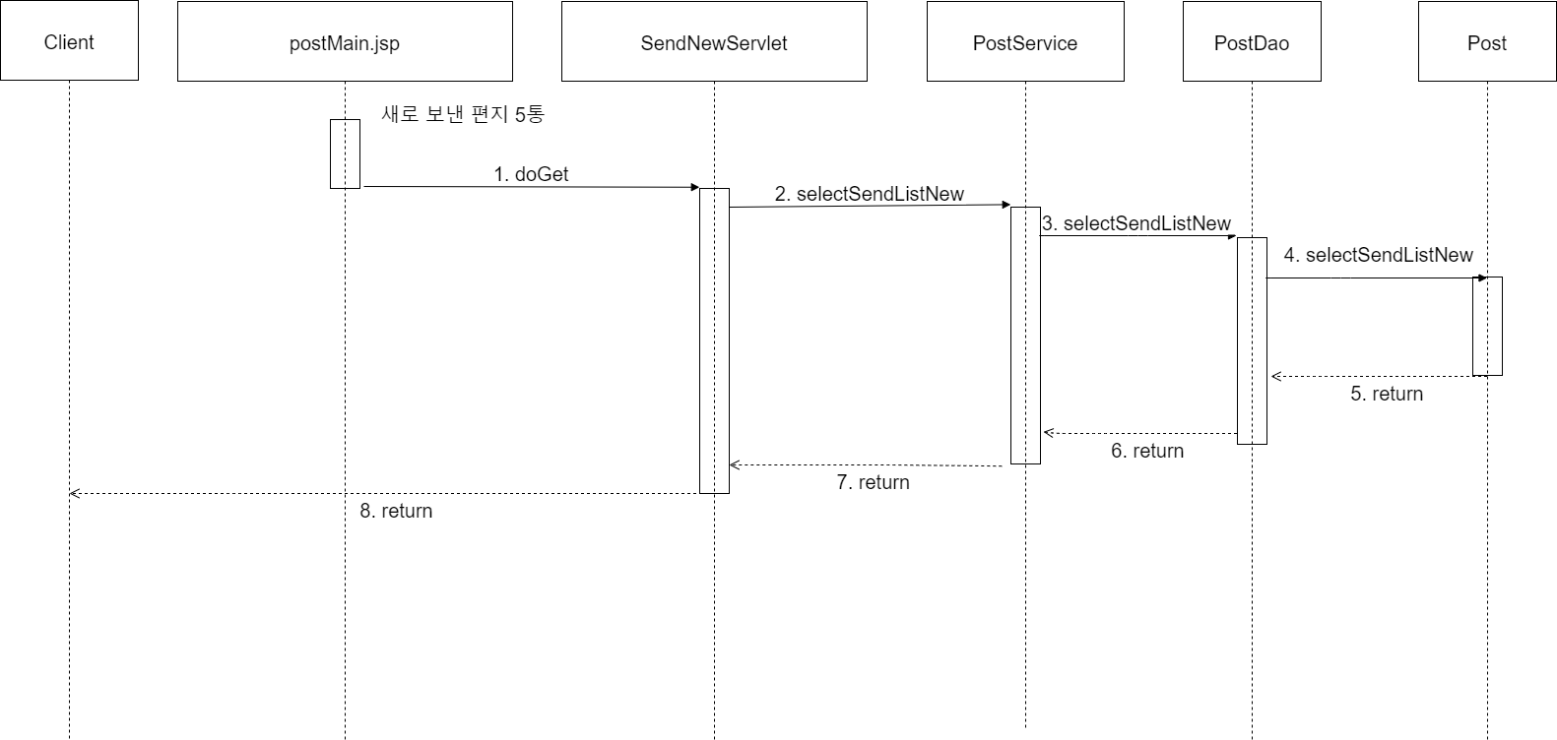
SendNew

Slide 46
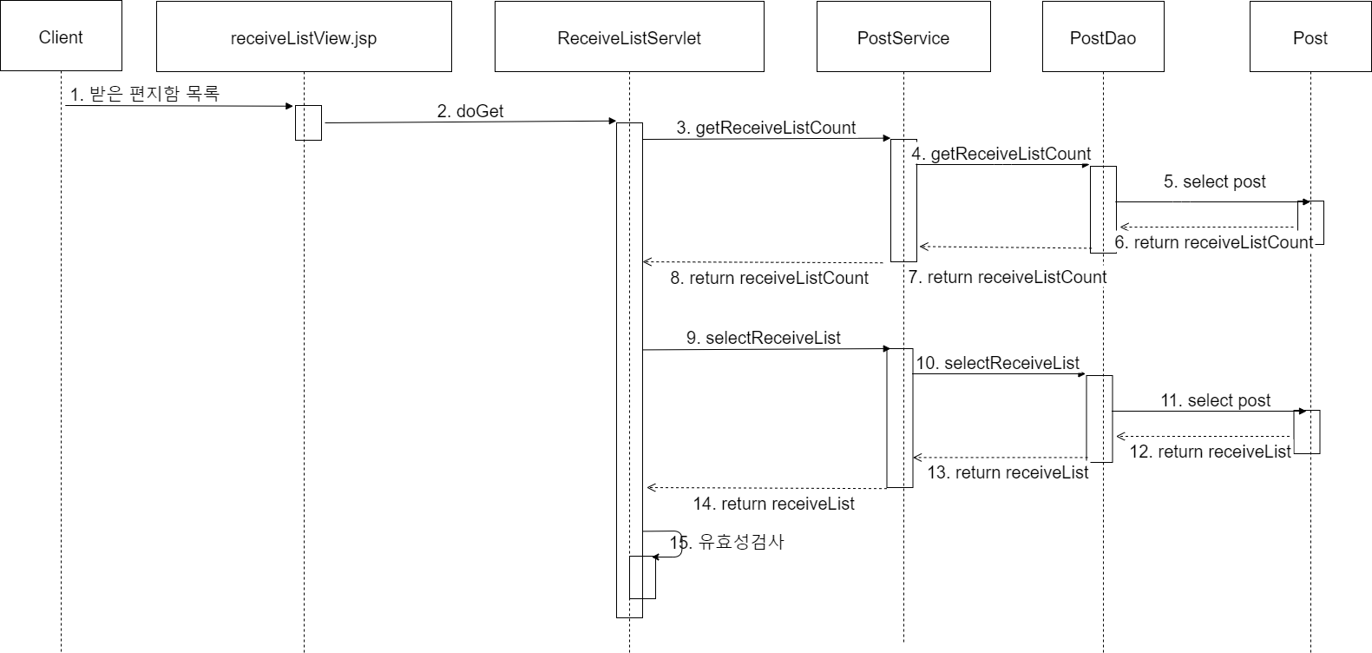
ReceiveList

Slide 47
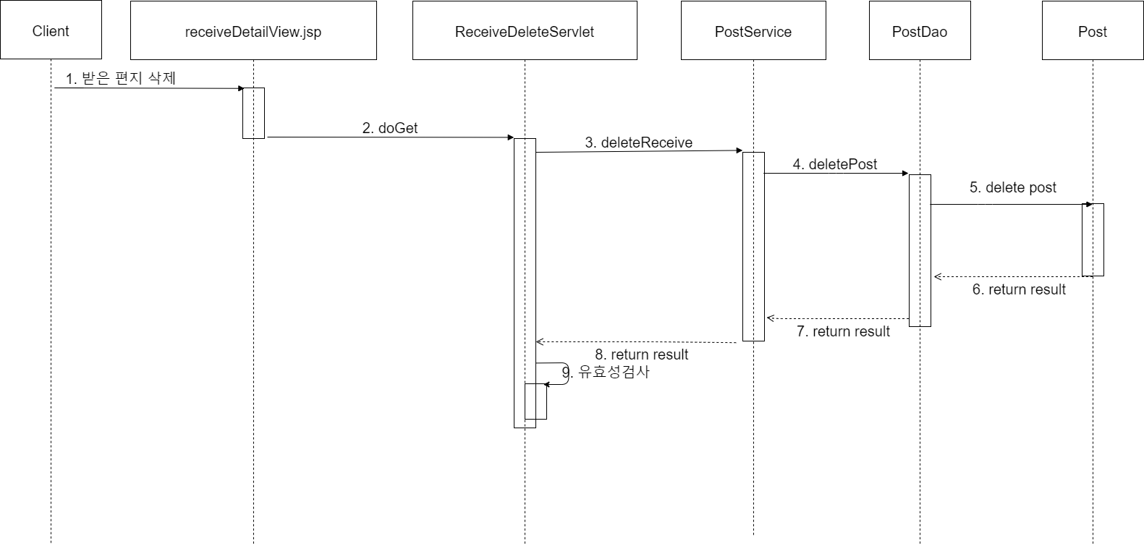
ReceiveDelete

Slide 48

ReceiveDetail

Slide 49
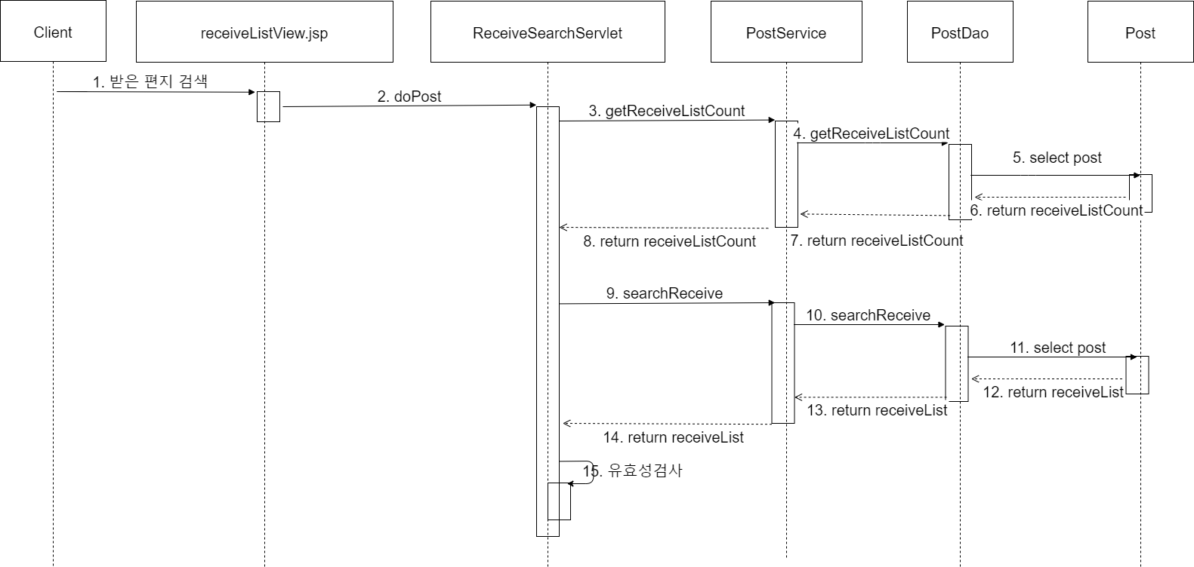
ReceiveSearch

Slide 50
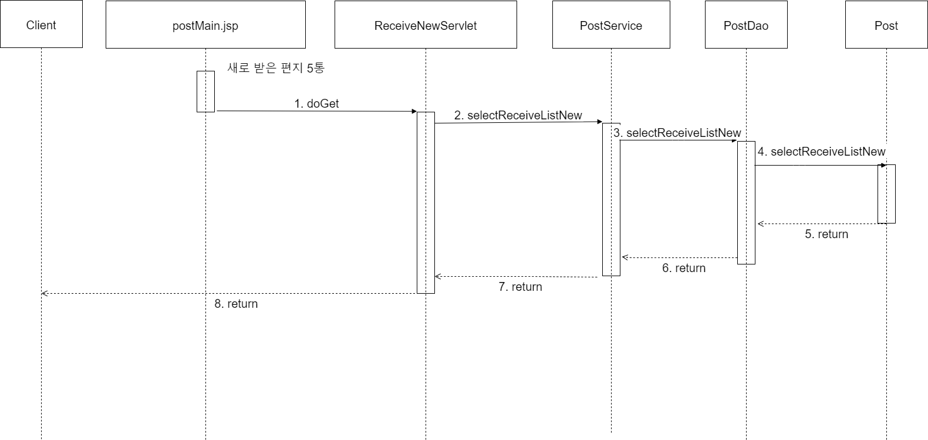
ReceiveNew

Slide 51

TempList

Slide 52
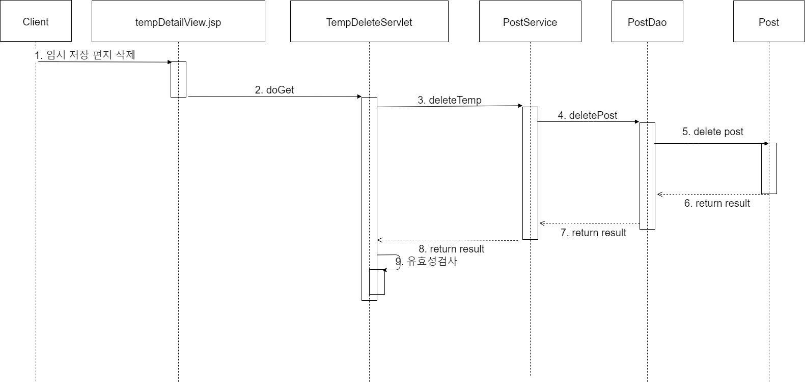
TempDelete

Slide 53
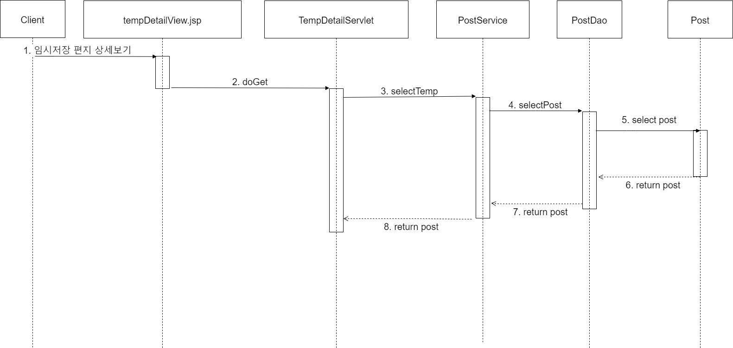
TempDetail

Slide 54
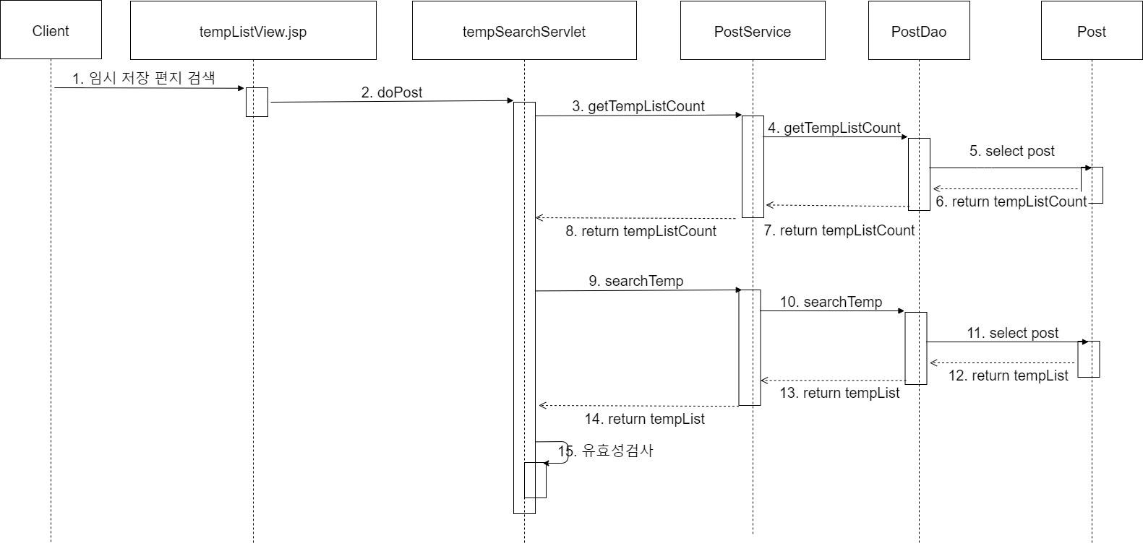
TempSearch

Slide 55
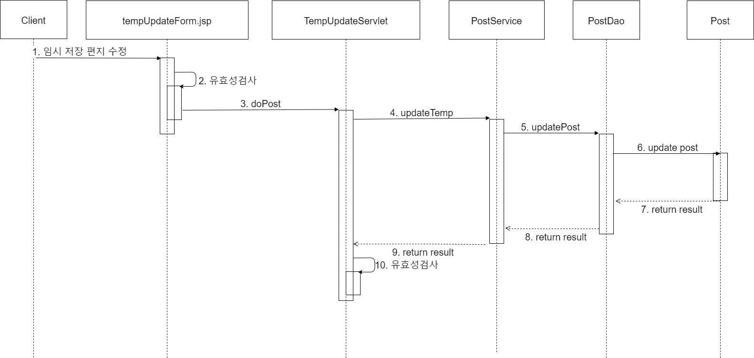
TempUpdate

Slide 56
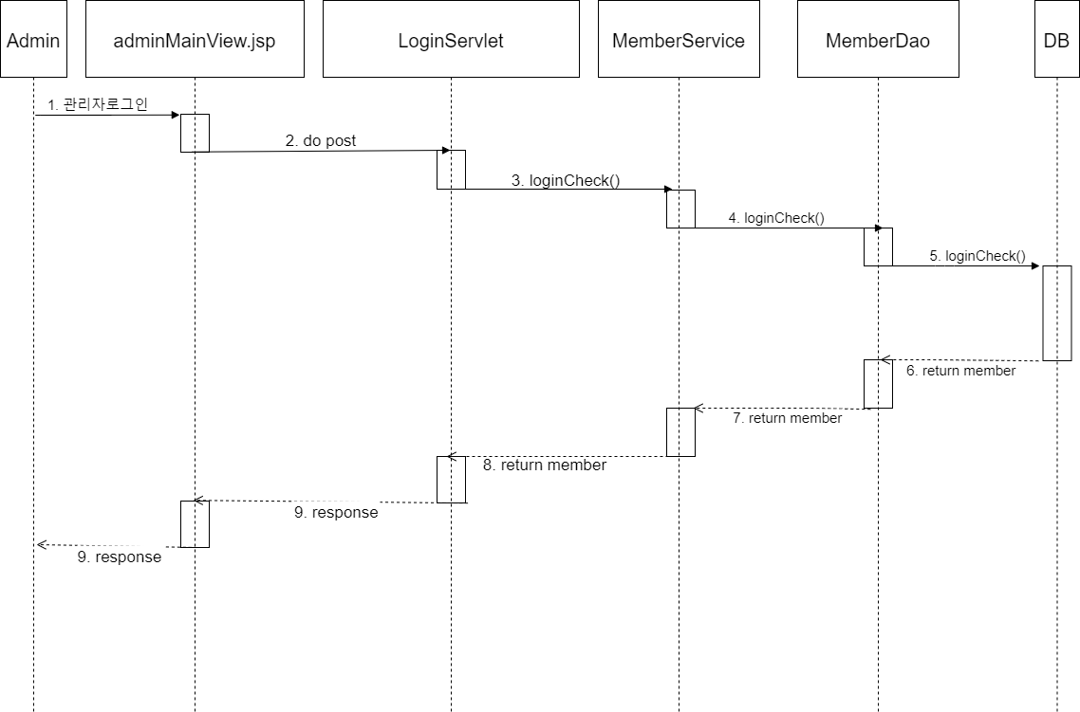
AdminLogin

Slide 57
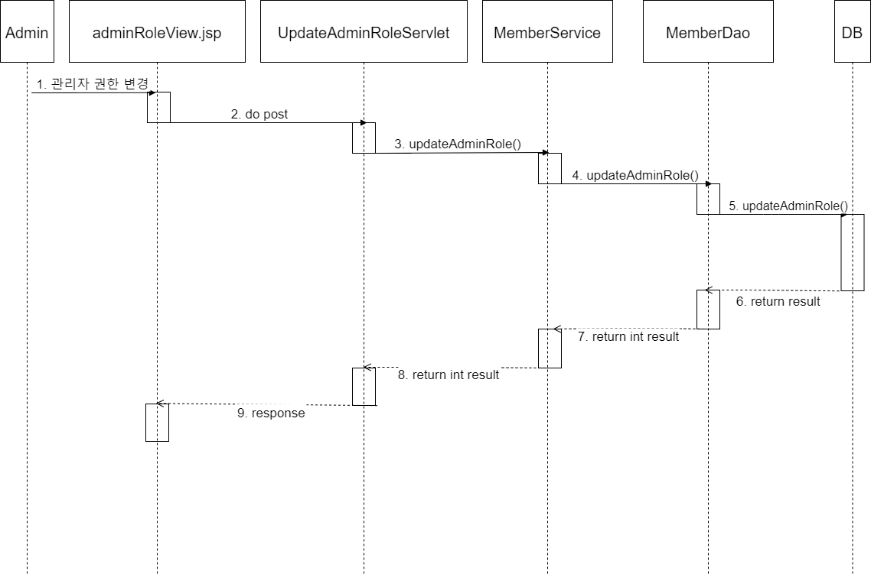
AdminRoleUpdate

Slide 58
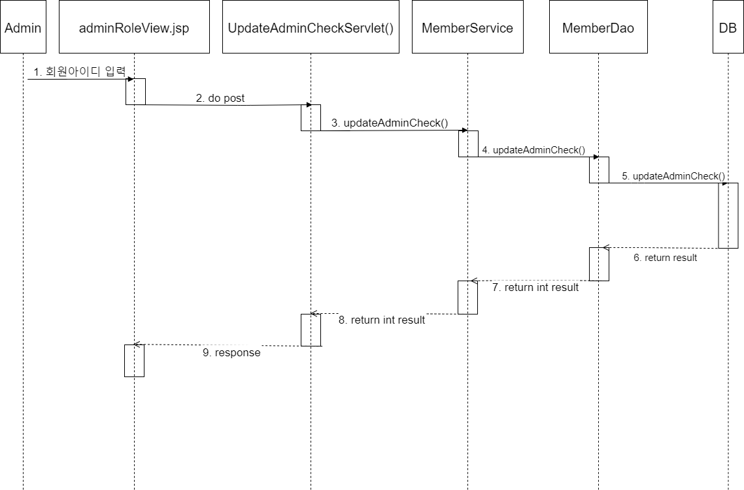
AdminCheckUpdate

Slide 59
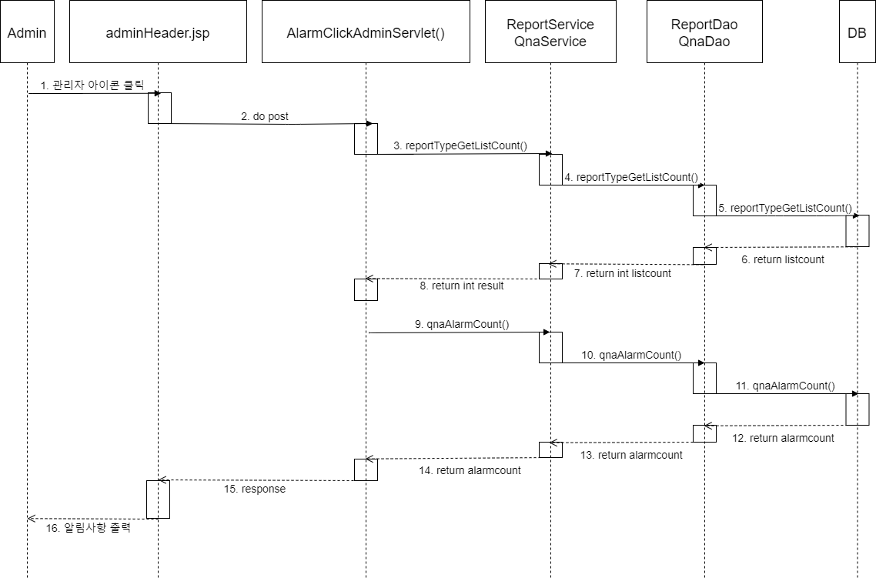
AdminAlarmCheck

Slide 60
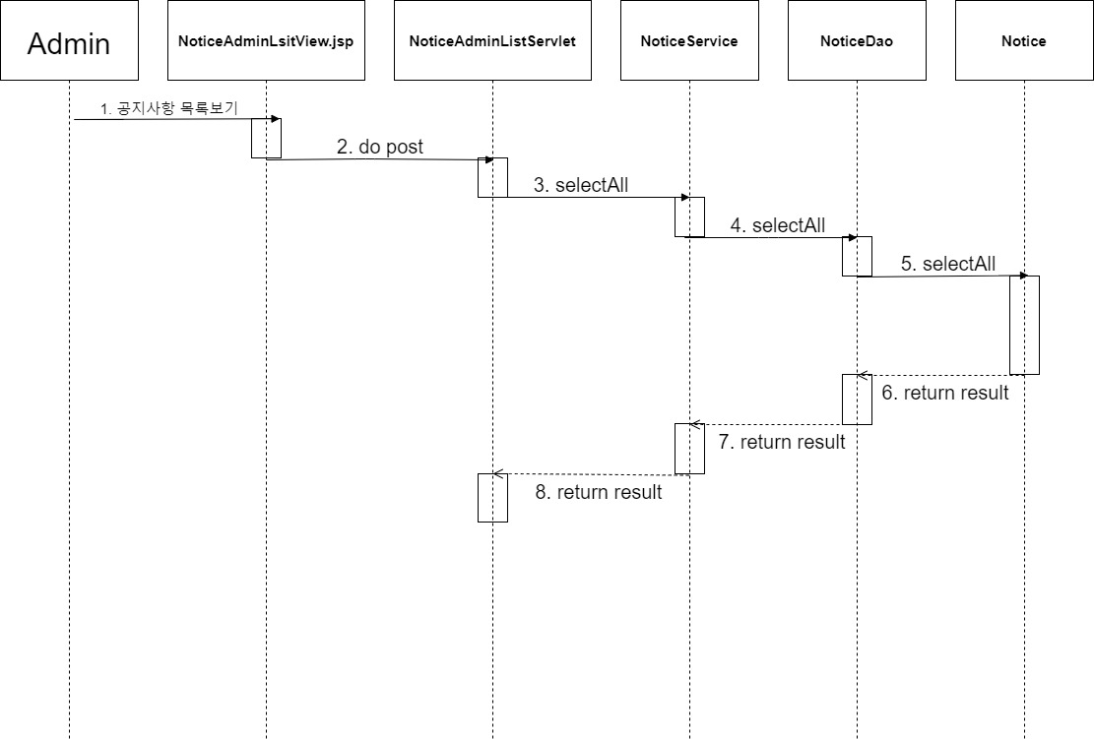
NoticeAdminListServlet

Slide 61

NoticeDetailServlet

Slide 62

NoticeAdminNewTop3Servlet

Slide 63

NoticeAdminInsertServlet

Slide 64

NoticeAdminUpdateServlet

Slide 65

NoticeDeleteServlet

Slide 66

BlackListServlet

Slide 67

BlackListDetailServlet

Slide 68

BlackListInsertServlet

Slide 69

BlackListUpdateServlet

Slide 70

InsertReport

Slide 71

DeleteReport

Slide 72

ReportList

Slide 73

ReportTypeList

Slide 74

ReportIdSearch

Slide 75

ReportCheck1

Slide 76

ReportCheck2

Slide 77

InsertPro1

Slide 78

InsertPro2

Slide 79

DeletePro1

Slide 80

ProList

Slide 81

ProContentSearch

Slide 82

QnaListServlet

Slide 83

QnaDetailServlet

Slide 84

QnaInsertServlet

Slide 85

QnaDeleteServlet

Slide 86

QnaUpdateServlet

Slide 87

QnaReplyInsertServlet

Slide 88

QnaReplyUpdateServlet

Slide 89

StatisicsCountUpdateServlet

Slide 90

StatisicsEnrollUpdateServlet

Slide 91

StatisicsLeaveUpdateServlet

Slide 92



